Slide 1
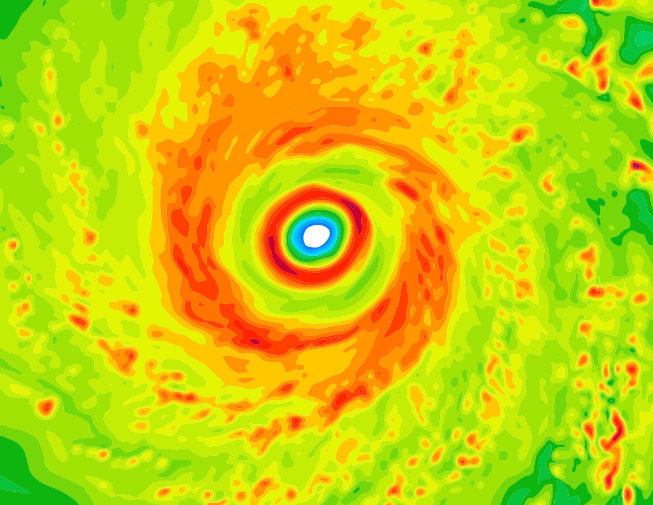
Secondary Eyewall Formation
dynamics
Sergio F. Abarca
September 08, 2014
College Park, MD

Slide 2
Outline
Introduction
What are secondary eyewalls (SEs)?
Why are they important?
Secondary eyewall formation hypotheses
Variety of hypothesis in the literature
Tropical cyclone intensification & BL dynamics
Numerical evidence
Mesoscale realistic & ideal
Sawyer-Eliassen
Slab boundary layer (BL)

Slide 3
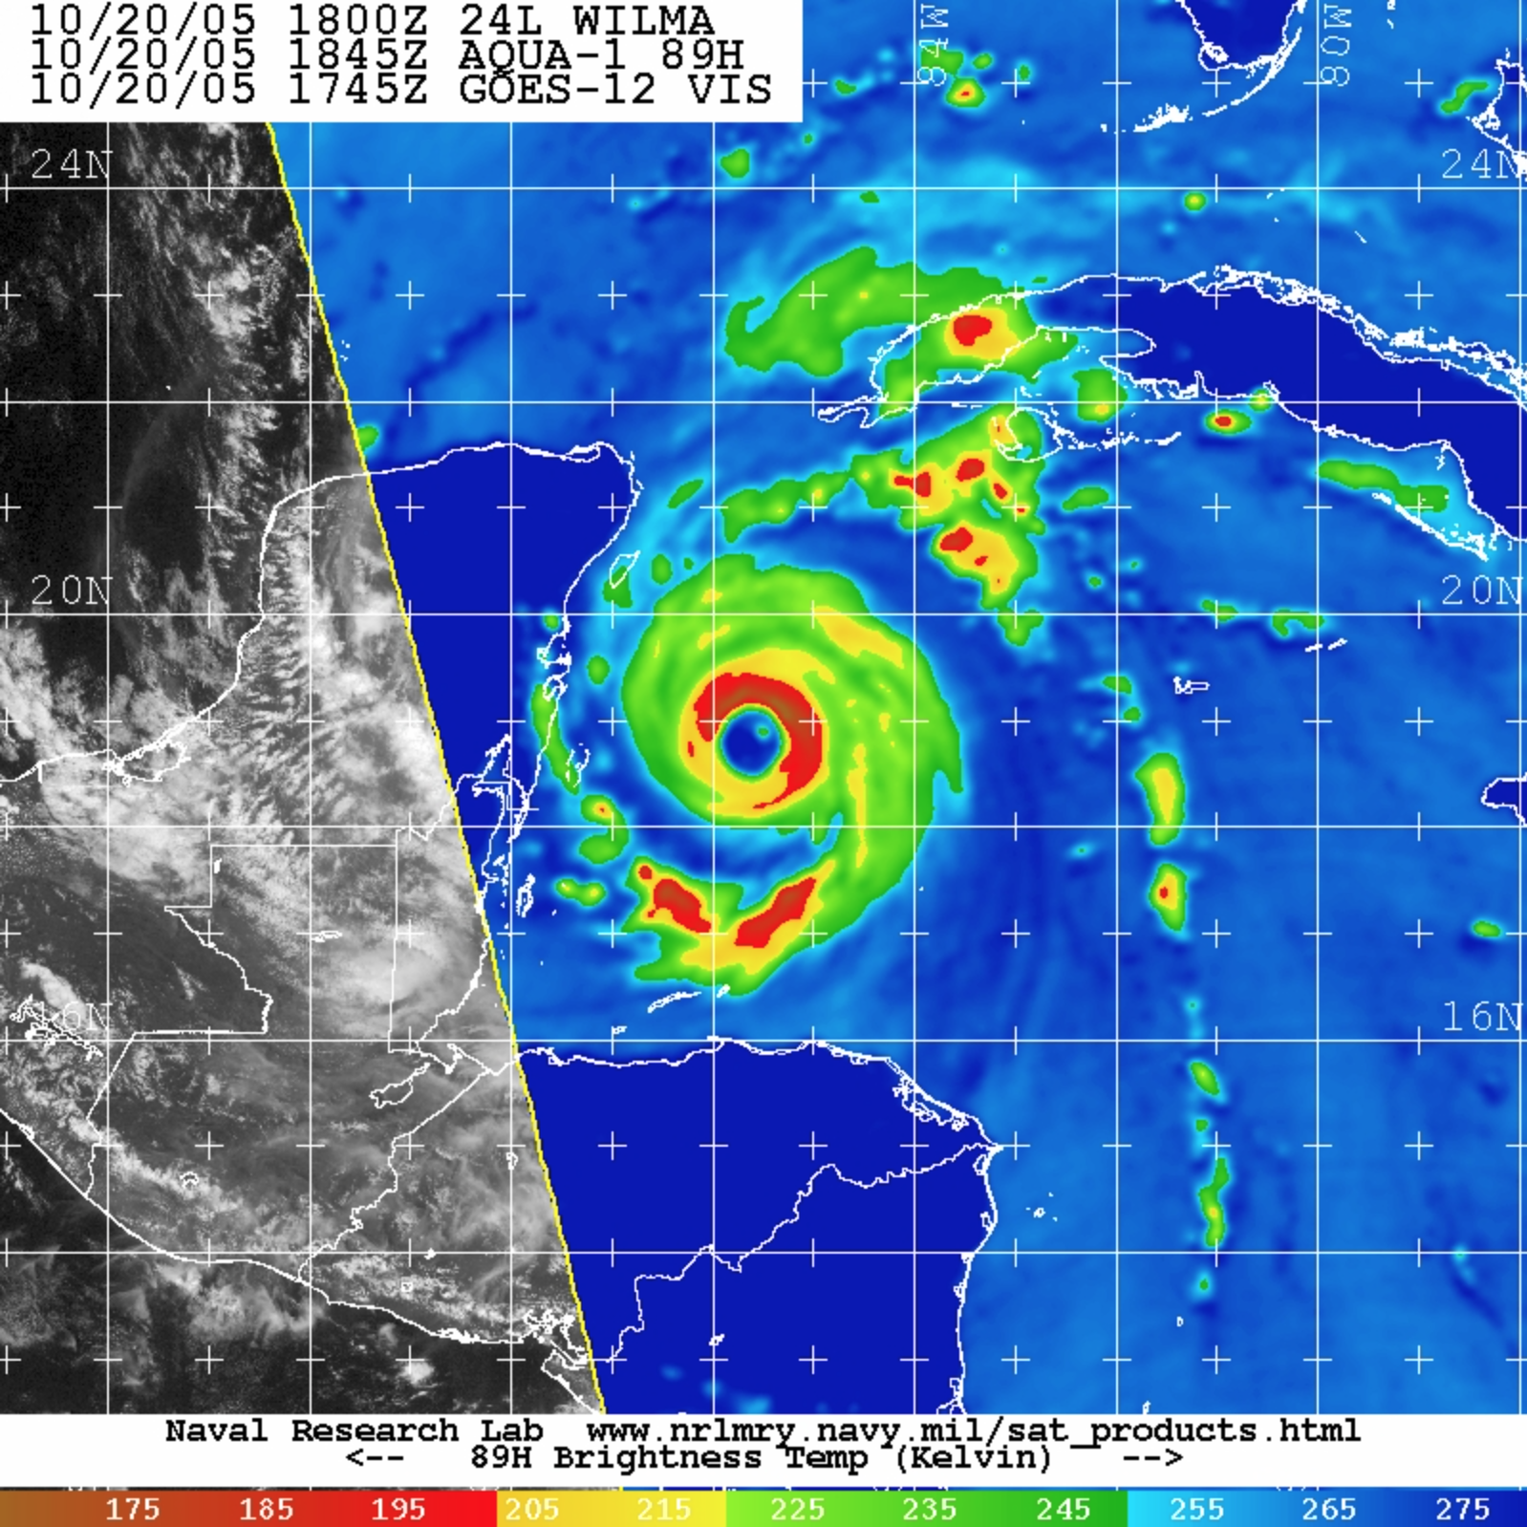
Notes:
To motivate my definition of secondary eyewalls
Walk you through the basics of hurricane structure
This is hurricane willma 2005. It is the strongest hurricane on record on the Atlantic basin. And it attained its strongest intensity when it was forming a secondary eywall.
You see a brightness temperature image overlayed on a visible product. Brightness temperature gets strongly attenuated in the presence of large hydrometeors like those that deep convection forms. So this image highlights where deep convection is located.

Slide 4
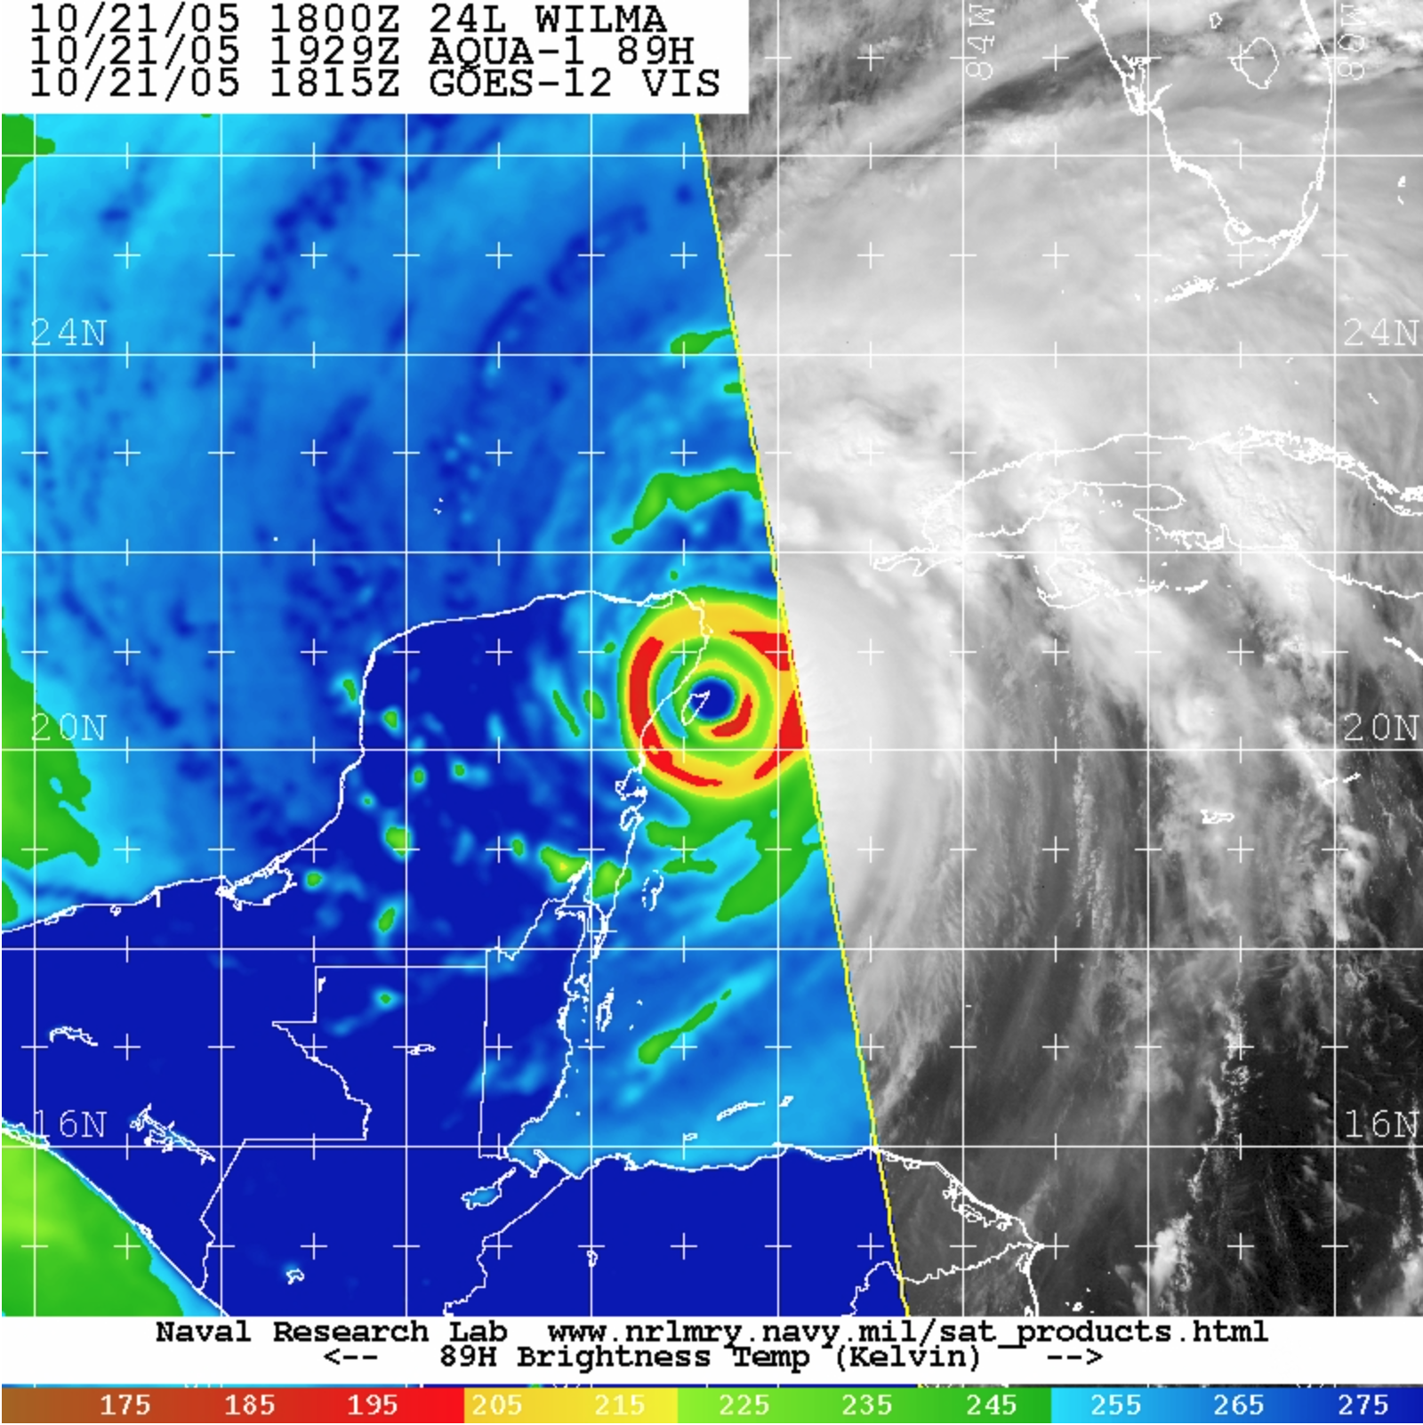
Notes:
http://www.goes-r.gov/users/comet/tropical/textbook_2nd_edition/print_8.htm

Slide 5
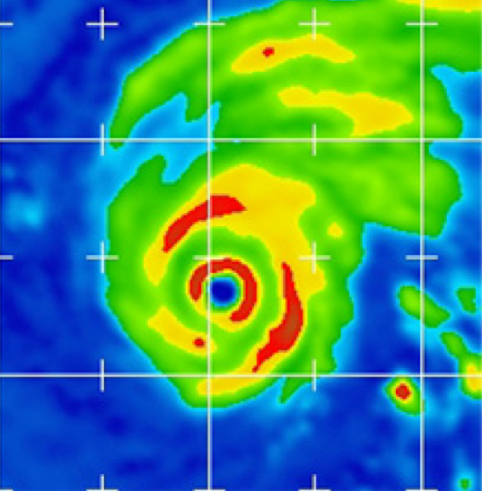
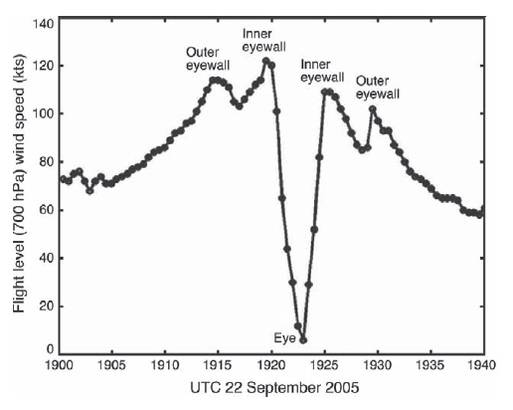
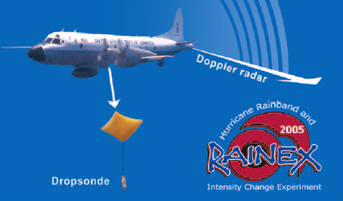
Rita (2005)
09/22 07:26
Houze et al. (2006)
Radar reflectivity (color)
Vertical velocity (contour m s⁻¹)
Secondary circulation (vector)
Bell, Montgomery and Lee. (2012)
Notes:
We know many of the characteristics of secondary eyewalls because we have been able to observe them.
North–south vertical cross section of quad-Doppler radar
is noted for its fine horizontal sampling resolution of about 0.4 km

Slide 6
Rita (2005)
09/22 07:26
Brightness temperature, from Aqua/AMSR-E (at 89 GHz)
Houze et al. (2006)
^{Secondary eyewall:}
A structure approximately concentric to the primary eyewall characterized by a maxima in:
^{a) Convective activity}
^{b) Tangential winds}
Notes:
to study the dynamics and interactions of the eye, eyewall, and rainbands [see Houze et al. (2006)
Research and operational aircraft missions were conducted
The peak intensity of 80 m/s
high microwave frequencies (85–89 GHz) by large or numerous ice particles lofted to high altitude by deep convection in the eyewall region produces low bright- ness temperatures
I’ll show you that just like the eyewall, the secondary eyewall has a maximum of convection and also a maximum in tangential winds

Slide 7
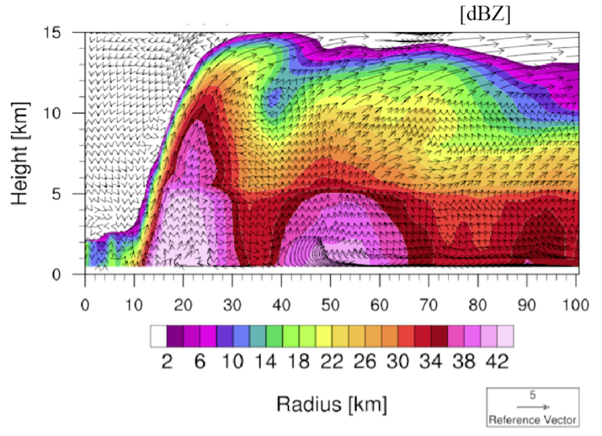
Observations
Description of structures
Evaluation of numerical simulations
Abarca and Corbosiero (2014)

Slide 8
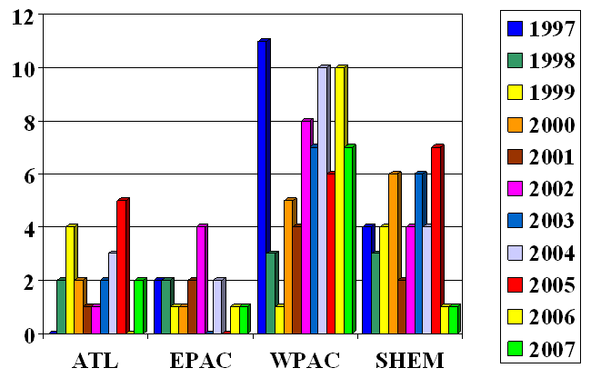
SEs are a common feature of intense storms
Not in mesoscale simulations!
~6% in AHW
# storms V≥120 kts, Cat 3
Why?
77%
56%
81%
50%
% with Concentric Eyewalls
Hawkins and Helveston (2008)
Notes:
So, why secondary eyewalls are important?
First understand the relevant physics and then make sure those physics are there.

Slide 9
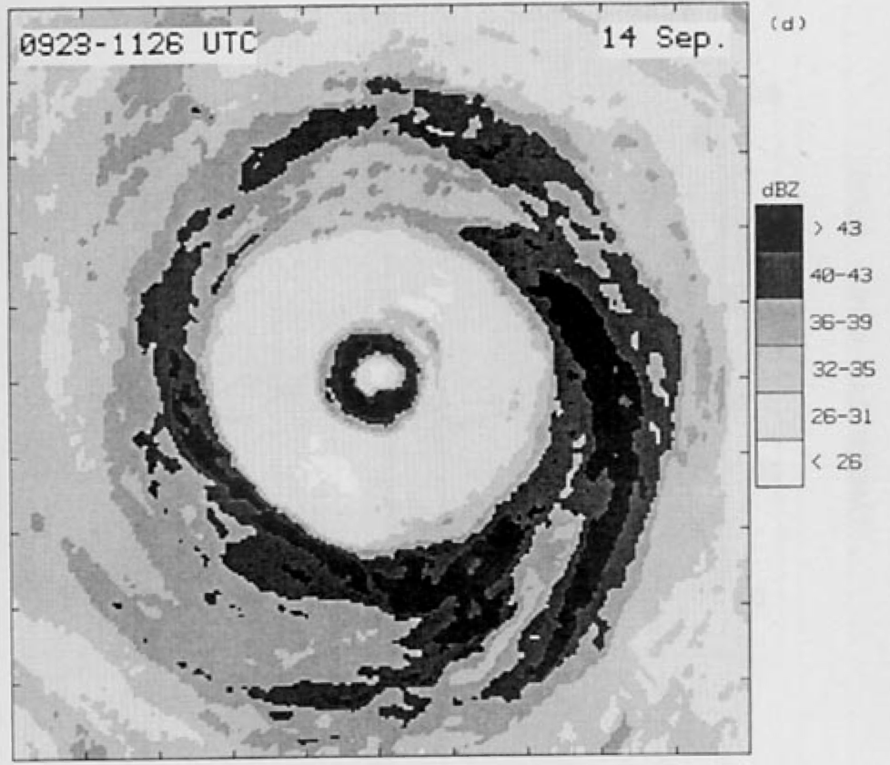
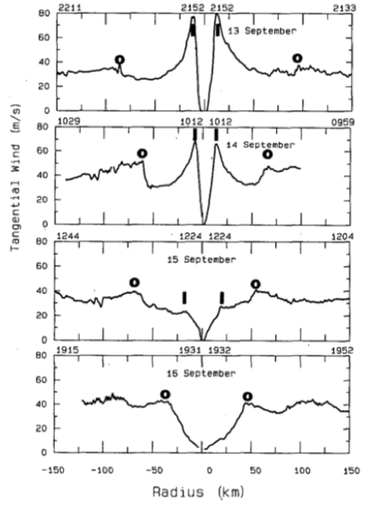
Gilbert (1988)
Eyewall Replacement Cycle (ERC)
Black and Willoughby (1992)

Slide 10
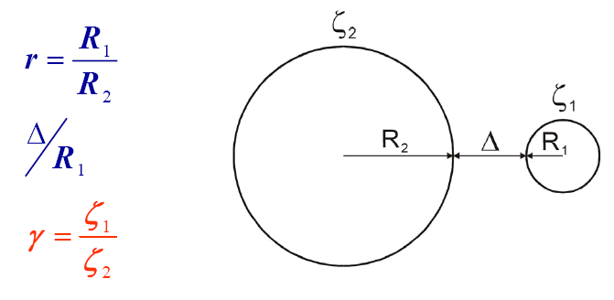
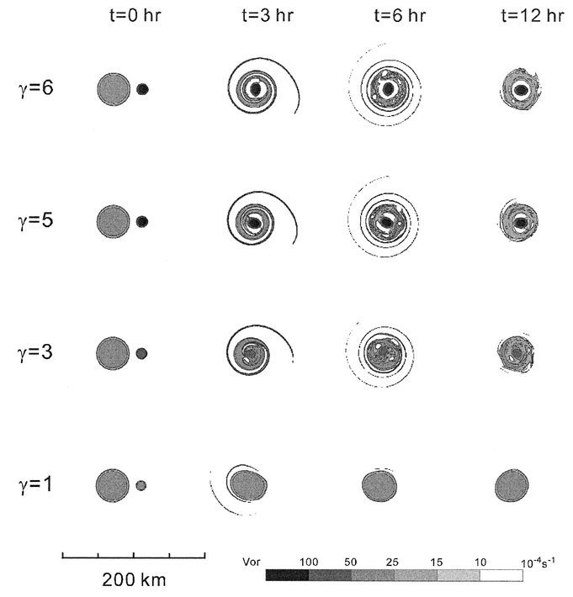
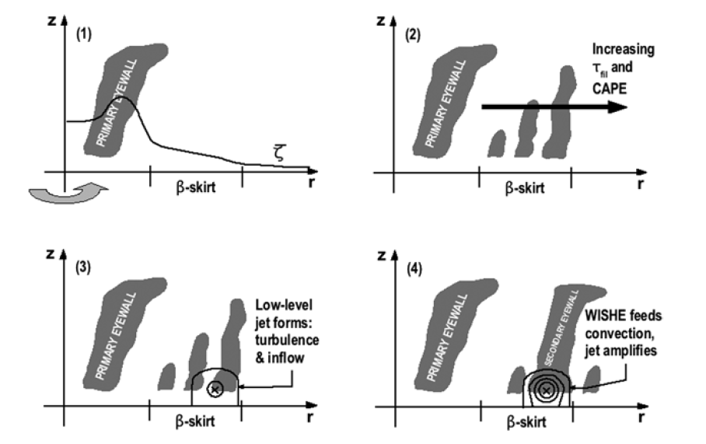
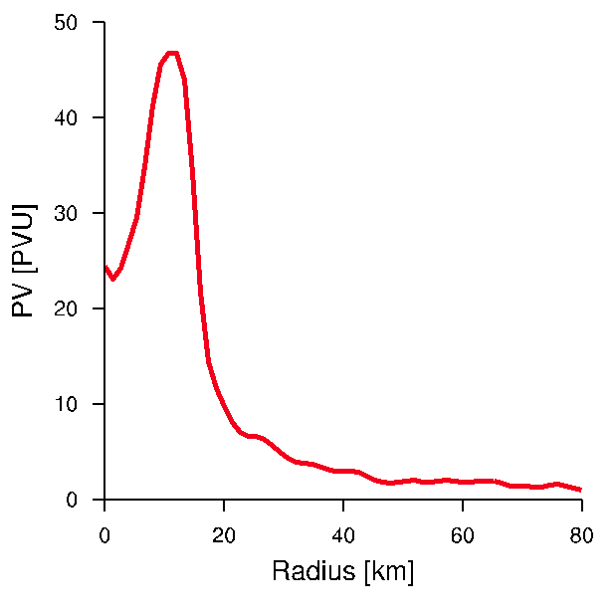
Variety of
SEF Hypotheses
Barotropic
vortex interactions
β-Skirt axisymmetrization
Kuo et al. (2004; 2008)
Vortex Rossby waves
(VRWs)
Terwey and Montgomery (2008)
Montgomery and Kallenbach (1997);
Camp and Montgomery (2001);
Abarca and Corbosiero (2011)
Menelaou et al. (2013)
Notes:
This jet is hypothesized to be generated by an anisotropic inverse cascade of kinetic energy.
The anisotropy is given by the radial gradient of potential vorticity and the source of kinetic energy is convective activity

Slide 11
Basic principle of hurricane intensification
M = rv + r²f/2
r
v
v = M/r - rf/2
As r decreases, v increases
What causes radial convergence of M?
Montgomery and Smith (2013)
Notes:
Recently, it has been proposed that

Slide 12
Radial convergence of M:
=0
Above the BL (M~conserved)
Radial gradient of diabatic heating
Convective structures
Presence of surface moisture fluxes
Described in terms of balanced dynamics
1st Mechanism
Within the BL (M~ not conserved)
Friction is important
In a coupled system of equations!
Presence of supergradient winds
2nd Mechanism
=0
The 2nd
mechanism is coupled to
the 1st
Thermal wind equation
Vortex
Subject to diabatic/frictional forcing
Develop a secondary circulation to remain in balance

Slide 13
The SE tangential wind maximum: a) Emerges within the BL? b) In the presence of supergradient flow?
Are balance dynamics a good framework to describe SEF?
Are BL dynamics relevant to SEF?
Observations
Notes:
Emphasize. Wit this I don’t mean to attribute SEF “exclusively to BL processes”
It is not BL alone, or BL solely or even in isolation

Slide 14
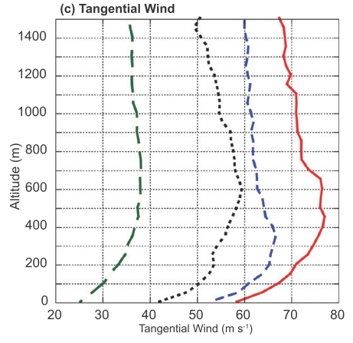
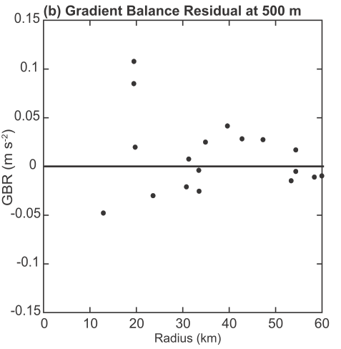
Rita (2005)
Dropsonde azimuthal mean
Tangential wind
Supergradient
Subgradient
Bell et al. (2012)
Didlake and Houze (2011)
Notes:
Add radial component

Slide 15
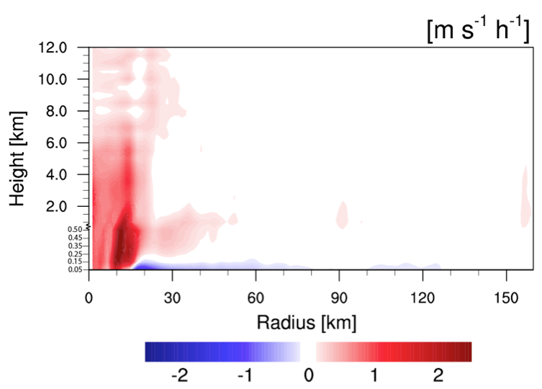
Advanced Hurricane WRF
Hr 30
Supergradient
Subgradient
Before V_{max} is observed
During SEF

Slide 16
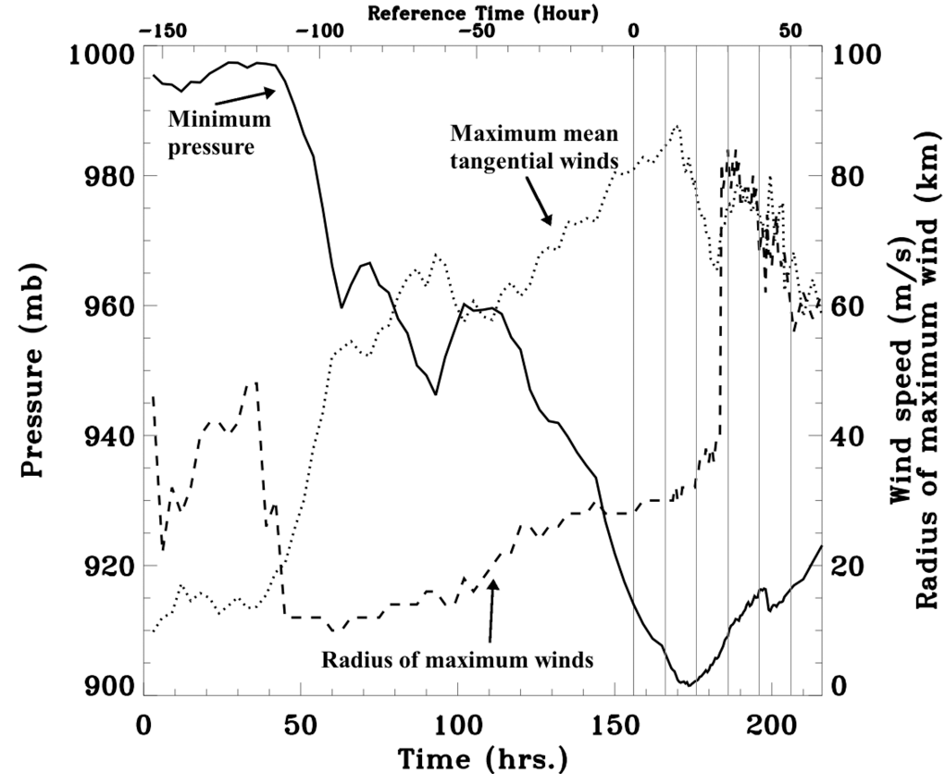
Idealized RAMS simulation
Walko et al. (1995) microphysics (7 species)
Louis (1979) scheme, surface fluxes
Three domains, 24, 6, 2 km
f-plane at 15ºN
SST 28ºC
Initial environment at rest
Weak mesoscale vortex
Gradient and hydrostatic balance
V_{max}=10 m s⁻¹ RMW at 75 km
Warm bubble, moisture perturbation
Terwey, Abarca & Montgomery (2013)
Abarca & Montgomery (2013)
Montgomery, Abarca, Smith, Wu & Huang (2013)
Abarca & Montgomery 2014a; 2014b)
Terwey & Montgomery (2008)

Slide 17
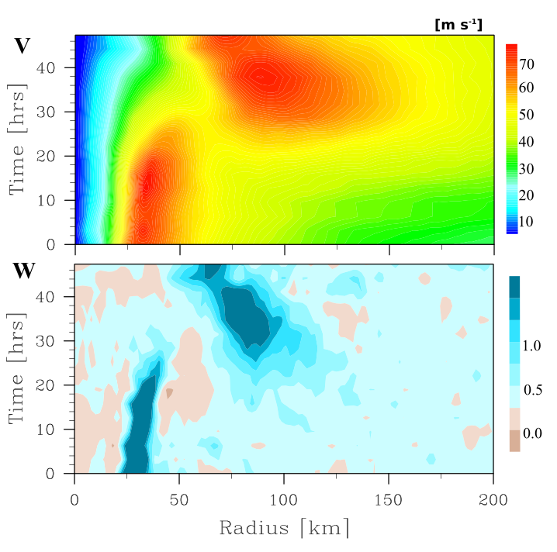
<v>
z=1,512m
hrs 4, 18, 23
<w>
Abarca and Montgomery (2013)

Slide 18
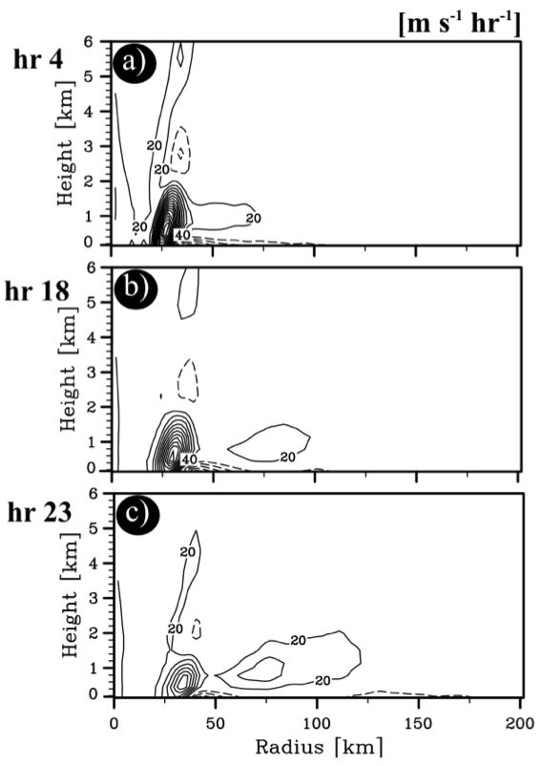
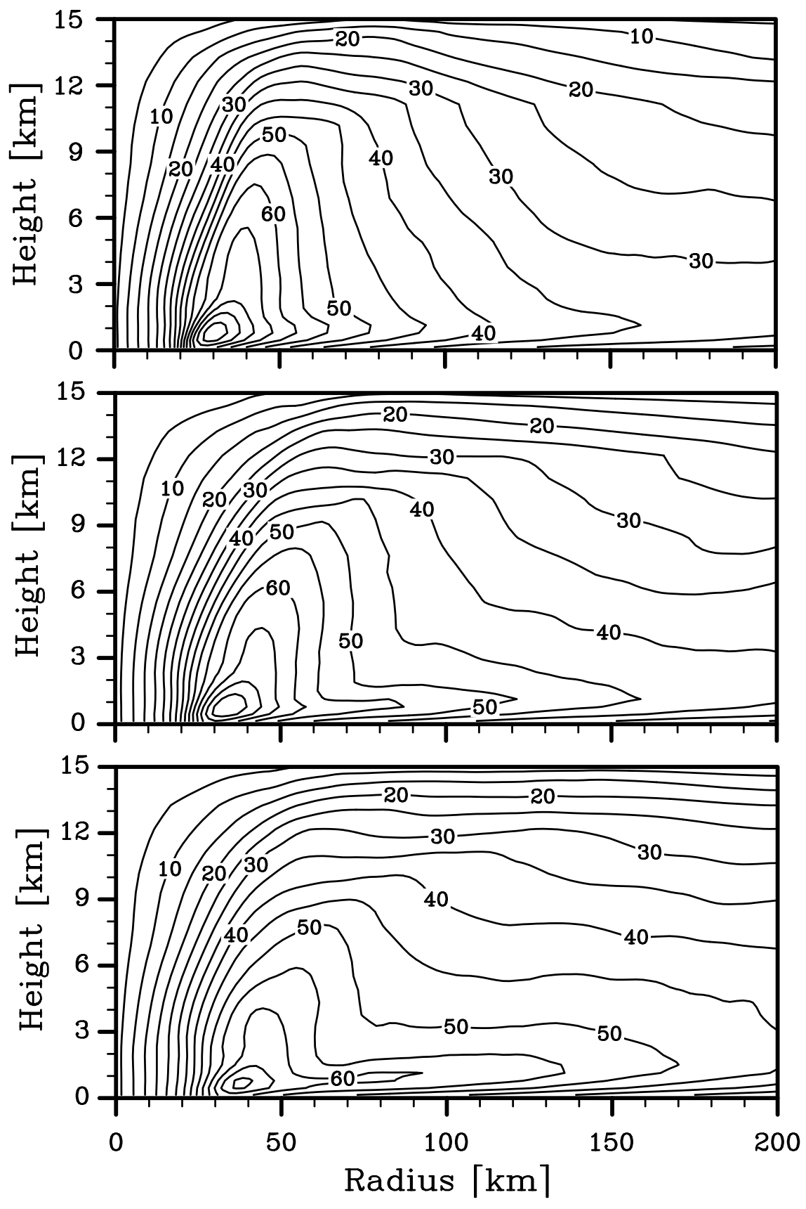
[ms⁻¹]
<v>
Abarca and Montgomery (2013)

Slide 19
How important are unbalanced dynamics in SEF?
Full physics integrations
Vs.
Balance dynamics
Secondary circulation & tangential wind tendency
Notes:
Until now I’ve shown you that the emergence of the secondary wind maximum occurs in the BL, where departures of balance are observed
The aim of the current paper is to investigate the extent to which a balanced approach is useful in understanding SEF

Slide 20
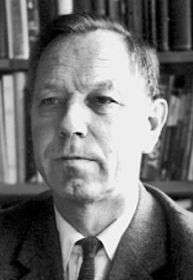
Arnt Eliassen (1915-2000)
Slow meridional circulation
Zonally symmetric general circulation
Driven by heat and momentum sources
Eliassen (1952)
Notes:
Iv;e told you that
scale analysis (Willoughby, 1979)
observations (Willoughby, 1990; Bell and Montgomery, 2008)
and numerical modeling and observations show that the system scale hurricane flow is in gradient and hydrostatic balance.
in regions where gradient wind balance and hydrostatic balance prevail, the tangential component of the flow satisfies the thermal wind equation. Balanced state
Neglecting the time derivative of density, which eliminates sound waves from the equations, the continuity equation takes the form
Except for small-scale motions, including gravity waves and convection, a scale analysis of the equations of motion for a rotating stratified fluid (Willoughby 1979) shows that the macro motions within a tropical cyclone are in a state of close hydrostatic equilibrium in which the upward- directed vertical pressure gradient force per unit mass is

Slide 21
Balanced vortex
Arnt Eliassen (1915-2000)
Continuity equation
Taking vertical and radial derivatives
Notes:
Iv;e told you that
scale analysis (Willoughby, 1979)
observations (Willoughby, 1990; Bell and Montgomery, 2008)
and numerical modeling and observations show that the system scale hurricane flow is in gradient and hydrostatic balance.
in regions where gradient wind balance and hydrostatic balance prevail, the tangential component of the flow satisfies the thermal wind equation. Balanced state
Neglecting the time derivative of density, which eliminates sound waves from the equations, the continuity equation takes the form
Except for small-scale motions, including gravity waves and convection, a scale analysis of the equations of motion for a rotating stratified fluid (Willoughby 1979) shows that the macro motions within a tropical cyclone are in a state of close hydrostatic equilibrium in which the upward- directed vertical pressure gradient force per unit mass is

Slide 22
Sawyer-Eliassen equation
a diagnostic equation for the streamfunction*
N², static stability
ζ_{a} = (1/r)(∂rv/∂r) + f , absolute vorticity
S = ∂v/∂z ,vertical wind shear
ξ = 2v/r + f, twice of the absolute angular velocity
b = -g{ρ - ρ(z)}/ρ*, buoyancy
F_{λ}, tangential component of friction
Q, diabatic heating rate
In hurricanes:
e.g. Willoughby (1979), Schubert and Hack (1982),
Shapiro and Willoughby et al. (1982) and Smith et al. (2005)
Bui et al. (2009)
*Boussinesq
Notes:
The Sawyer-Eliassen equation is a diagnostic equation for the meridional stream function in the radius-height plane. This equation determines the meridional circulation required to maintain a vortex, under heat and momentum forcing, in hydrostatic and gradient wind balance.
The Boussinesq approximation in height coordinates is generally too restrictive for flow in a deep atmosphere, but it is possible to formulate the SE equation without making any assumptions on the smallness of density perturbations.
Where it is satisfied, it imposes a strong constraint on the evolution of a vortex that is being forced by processes such as diabatic heating or friction, processes that try to drive the flow away from balance. Indeed, in order for the vortex to remain in gradient and hydrostatic balance, a transverse, or secondary circulation is required.
Elliptic partial differential equation provided that the discriminant is possitive
Previous use of the Sawyer-Eliassen equation
Moller and Shapiro (2002) influence of an upper-level trough on the intensification of the storm. They diagnosed the dia- batic heating and azimuthal momentum sources from azimuthal averages of the model output at selected times and solved the SE equation with these as forcing functions to determine the contributions to the secondary circula- tion from these source terms.
Hendricks et al. (2004) and Montgomery et al. (2006): investigate the extent to which vortex evolution in a three-dimensional cloud-resolving numerical model of hurricane genesis could be interpreted in terms of balanced, axisymmetric dynamics
Shapiro and Willoughby (1982) derived a more general form of the SE equation based on the so-called anelastic approximation and presented some basic solutions for a range of idealized forcing scenarios such as point sources of heat and tangential momentum.
Schubert and Hack (1983) showed that an axisymmetric balance theory for an evolving vortex could be elegantly formulated using potential radius instead of physical radius as the radial coordinate (section 2)
Schubert et al. (2007) forced subsidence in hurricane eyes
Shapiro and Montgomery, 1993; Montgomery and Kallenbach, 1997: They study axisymmetric aspects of vortex evolution
Challa and Pfeffer (1980) and Pfeffer and Challa (1981): Interaction of the TC with its environment
Schubert and Alworth (1987), who examined the intensification of a hurricane-scale vortex in response to a prescribed heating function near the axis of rotation. They used isentropic coordinates to simplfy the equation but they payed the cost of distortions associated with isentropic coordinates going down at the eye

Slide 23
V, Θ, ρ
+ Q y F_{λ}
= ψ → u, w
Required to maintain the vortex in balance
Notes:
specify a balanced vortex

Slide 24
<v>
z=1,512m
Hr 18
<w>
Abarca and Montgomery (2013)

Slide 25
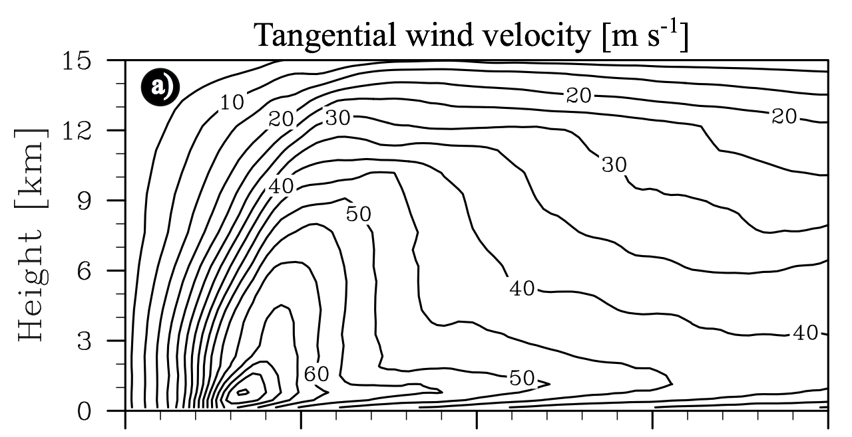
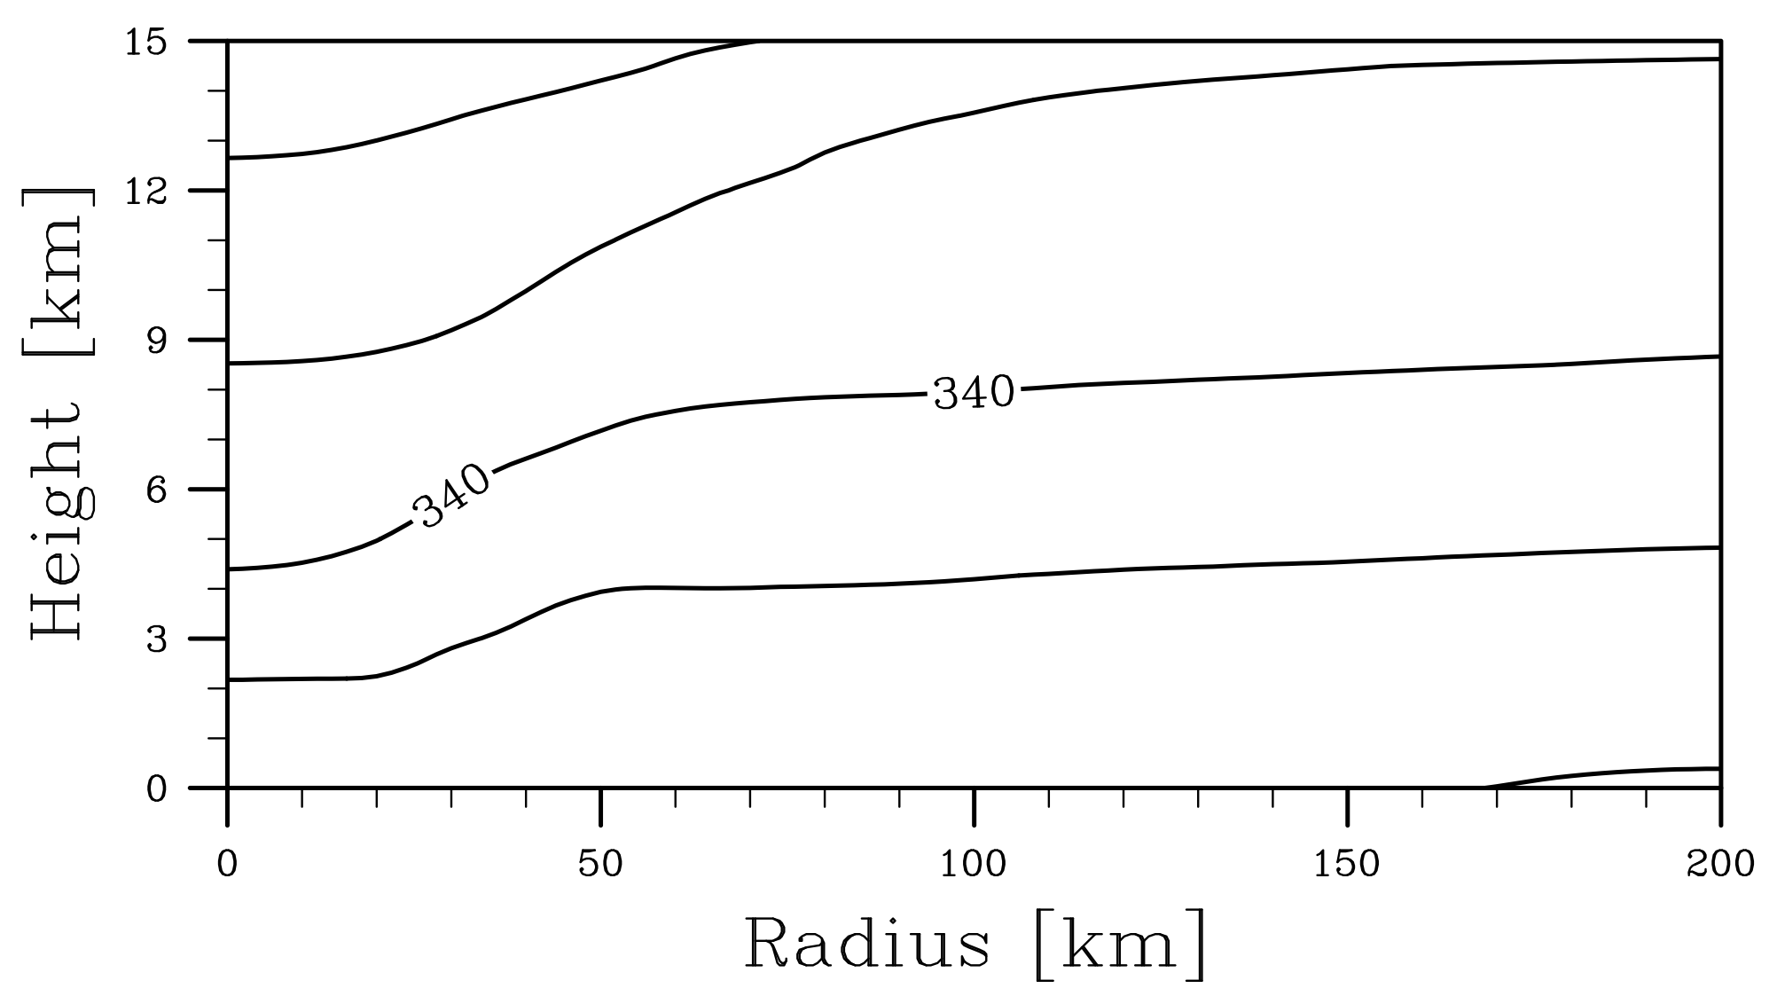
Hr 18
RAMS
Azimuthal
Average
Potential temperature [K]

Slide 26
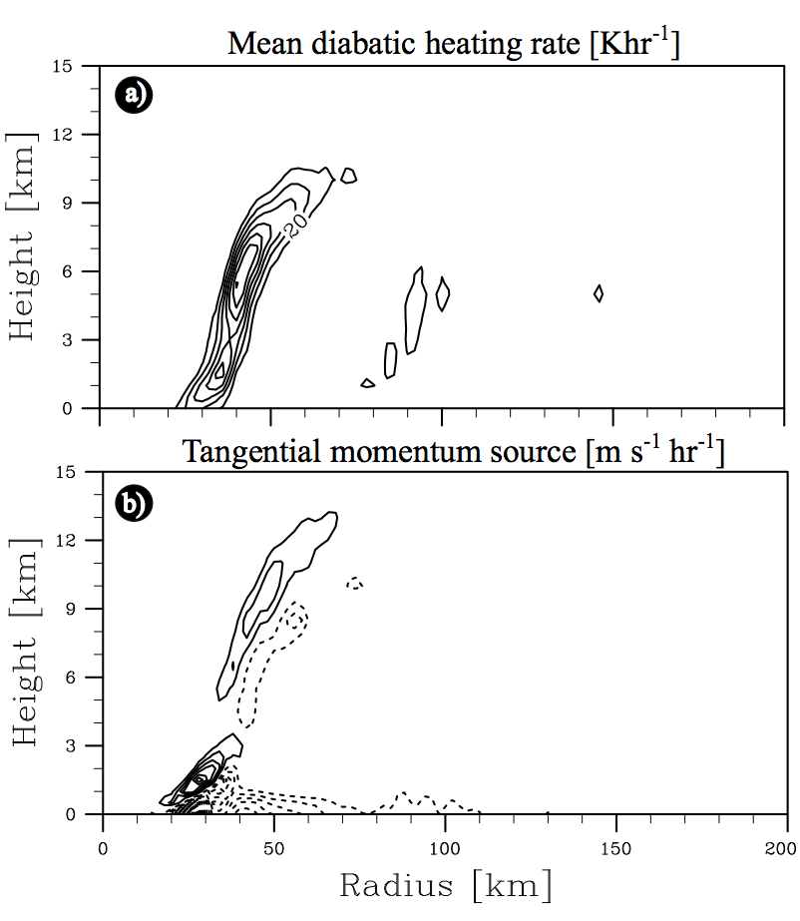
Contours every 10 K⁻¹
Contours every 10 Khr⁻¹
Abarca and Montgomery (2014)
Notes:
Q – difference between the total diabatic heating rate and azimuhtally averaged eddy heat fluxes
F_lambda- difference between the local time change of tangential momentum and the sum of the mean vorticity flux and the mean vertical advection
This is,
In Q we neglect subgrid scale processes
In F_lambda we compute it as residual

Slide 27
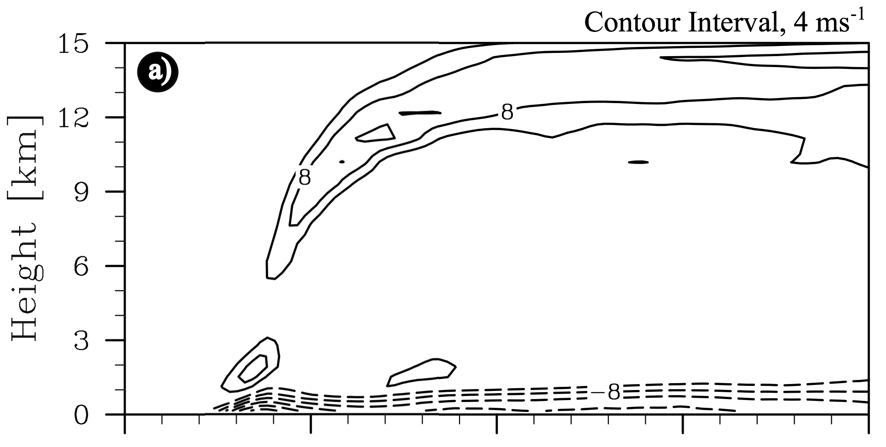
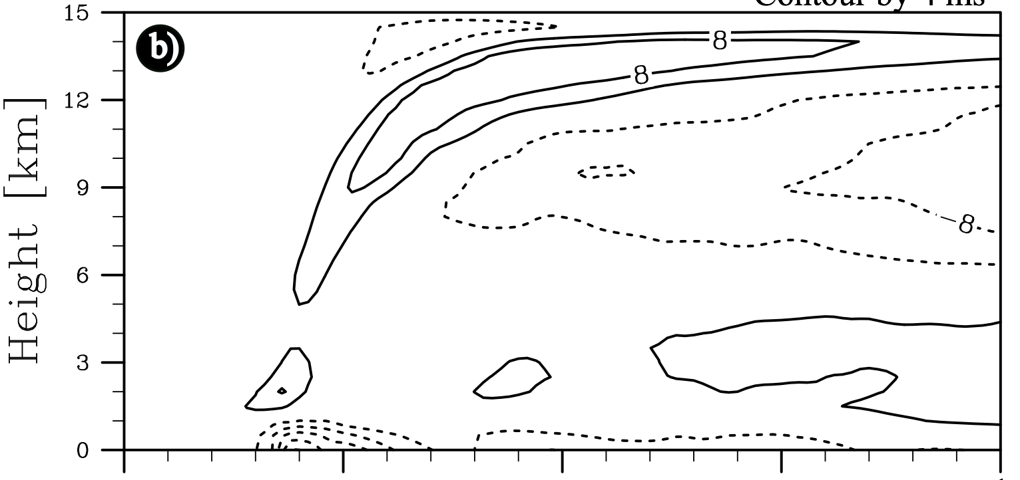
Radial velocity
Hr 18
RAMS
Azimuthal
Average
Sawyer-Eliassen
Abarca and Montgomery (2014)

Slide 28
Hr 18
RAMS
0.0
__
Sawyer-
Eliassen
Abarca and Montgomery (2014)

Slide 29
Conclusions
Secondary eyewalls are:
common in nature
Associated to intensity changes
Secondary wind maxima emerges
Within the BL
In the presence of supergradient winds
Balanced dynamics alone,
as traditionally defined (Shapiro & Willougby 1982), do not capture SEF spin up
∴ Unbalanced dynamics are at the core of SEF

Slide 30
Are BL dynamics alone capable to generate secondary wind maxima?
-in their response to an imposed hurricane wind field above-
Notes:
Emphasize. Wit this I don’t mean to attribute SEF “exclusively to BL processes”
It is not BL alone, or BL solely or even in isolation

Slide 31
Model parameters
Eddy diffusivity
K=1 × 10⁴ m² s⁻¹
Boundary layer depth
h=2 km
Drag coefficient
Cd…
u, radial
v, tangential
Shapiro (1983), Abarca and Montgomery (2013)

Slide 32
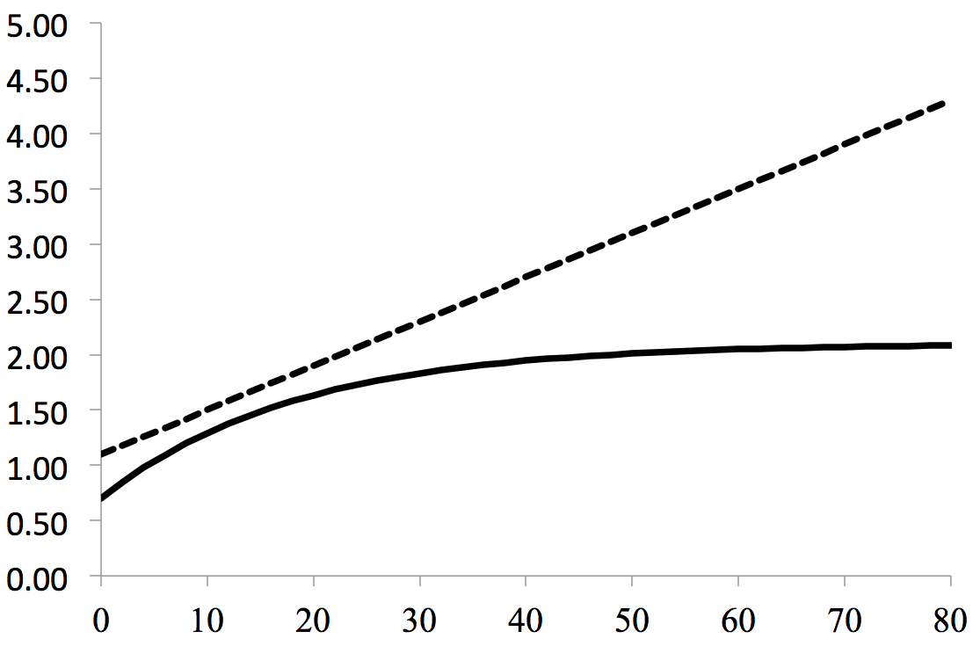
Roll (1965), C_{D}=(1.1+0.04(u²+v²)0.5) × 10⁻³
C_{D} X 10 ⁻³
Thomsen et al. (2012)*, C_{D}=0.7 × 10⁻³ +1.4 × 10⁻³(1-exp(-0.055 u²+v²)0.5)
Wind magnitude [m s⁻¹]
Sensitivity experiments to the 3 model parameters render results consistent with those presented here
*After Bell et al. (2012), based on CBLAST (Black et al., 2007; Drennan et al., 2007; French et al., 2007; Zhang et al., 2008)

Slide 33
Initial condition RAMS’s integration, at hour 13 at h=1,512m
BL dynamics are capable of developing a secondary tangential wind maximum, as a response to a forcing without it
Notes:
The slab-model boundary-layer calculations by Smith and Vogl (2008) and Smith et al. (2008) show that the tan- gential winds tend to become supergradient in the inner core

Slide 34
Conclusions… 2
…Balanced dynamics alone, (Shapiro & Willougby, 1982) do not capture SEF spin up
Boundary layer dynamics *alone* can generate secondary wind maxima
Quantitatively consistent with that of the mesoscale integration
Contracts radially!
Notes:
new ways to think about it...

Slide 35
RAMS/Slab-BL
Hr 13/ Init cond
Hr 18/Hr 5
Hr 23/Hr 10
Radial profiles... u & v :
a) Are qualitatively consistent with that found in the RAMS simulation
b) Contract radially!!
Abarca and Montgomery (2013a)

Slide 36
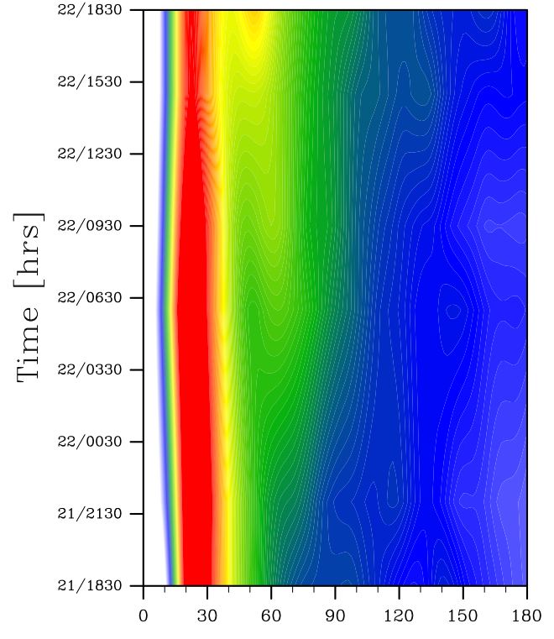
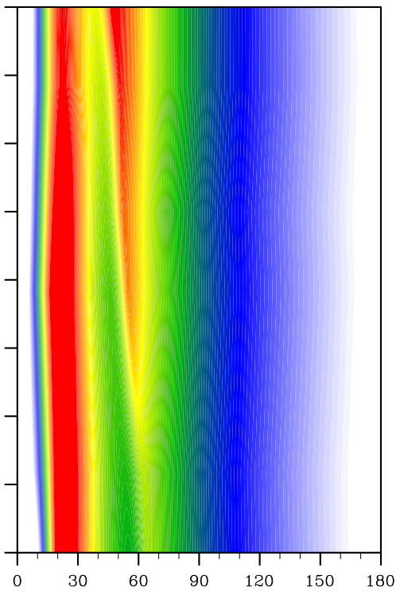
RAINEX initial conditions & forcing
Slab BL equilibrium
49 integrations
SEF is a robust feature in the Slab-BL model
Abarca et al. (2014)

Slide 37
<v>
z=1,512m
Hr 36
<w>
Abarca and Montgomery (2014b)

Slide 38
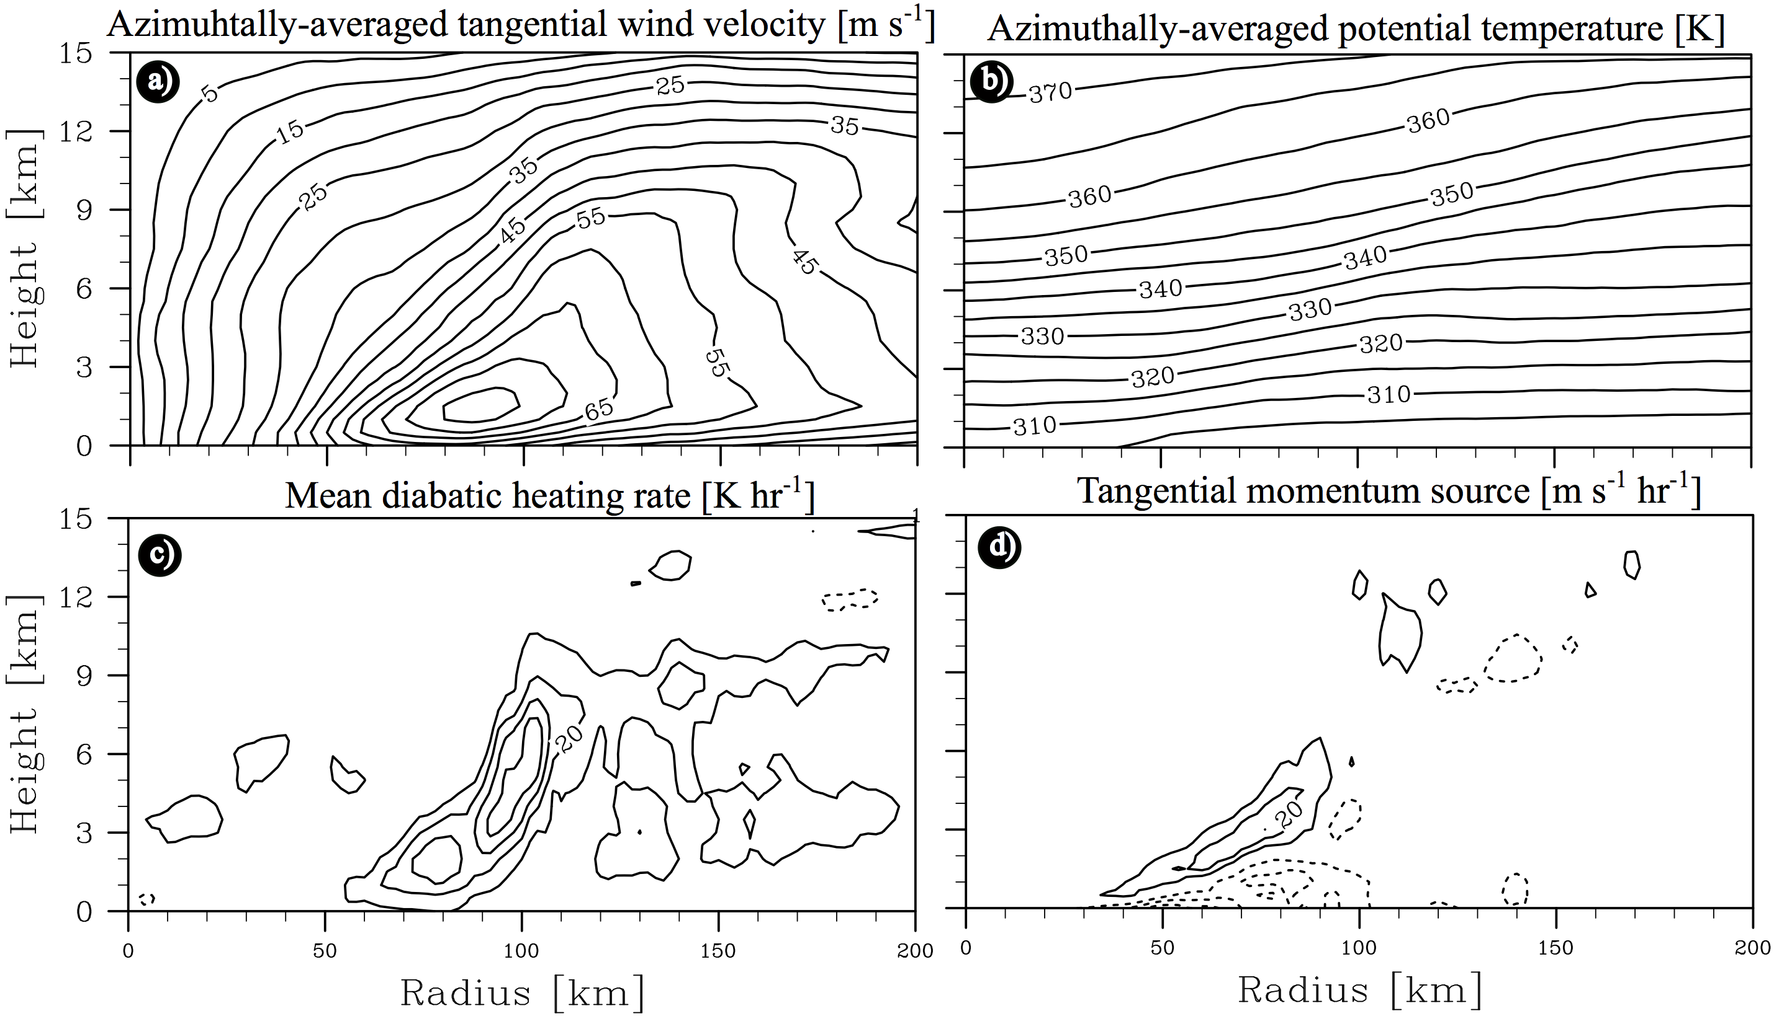
Abarca and Montgomery (2014b)

Slide 39
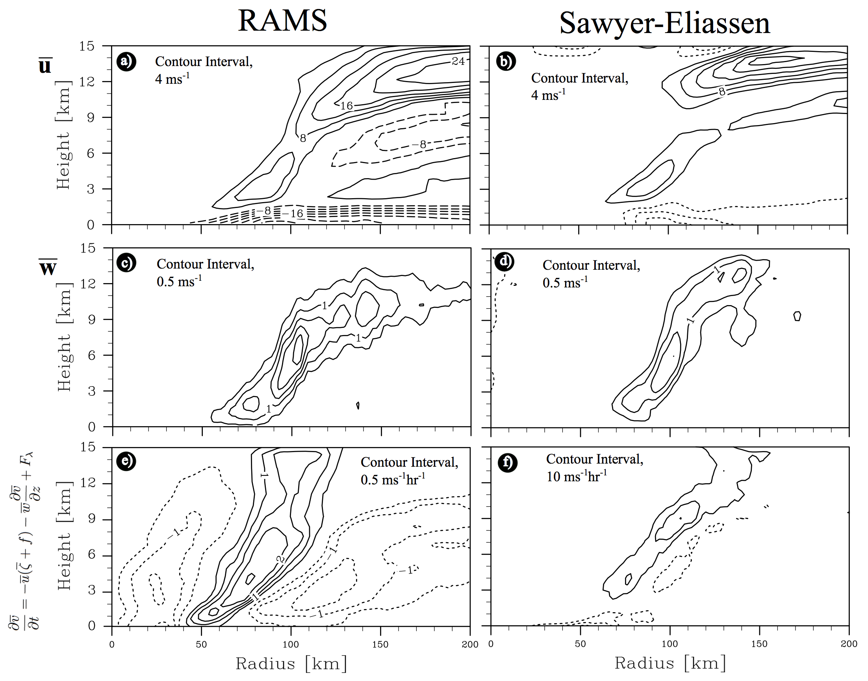
28 ms⁻¹
12 m s⁻¹
Abarca and Montgomery (2014b)

Slide 40
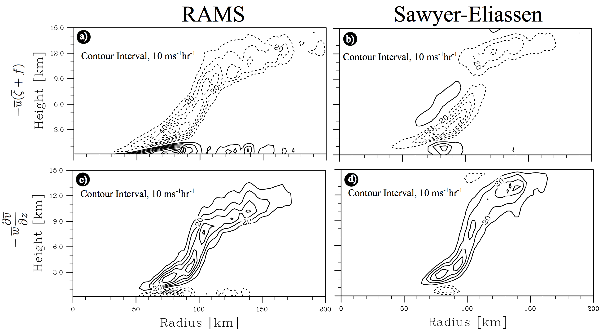
Abarca and Montgomery (2014b)

